Slide 1
Final Software Project
Victor Garces
University of Arizona Global Campus
CST499: Capstone for Computer Software Technology
Professor Amr Elchouemi
October 4th , 2021

Slide 2
SRS Document for Student Online Course Registration
Introduction
The system getting produced is the student online course registration system. The online course registration system is getting produced for students interested in enrolling in courses for the upcoming semester. The SRS will describe the functional and non-functional requirements needed for the school to implement the ability to allow students to enroll in courses.
Purpose
The purpose is to help students enroll in online courses for an incoming semester.
Intended Audience
This document is intended for the developers, academic staff, and students.

Slide 3
Product Functions
New user registration that includes account and profile creation.
Each new user should have a unique ID associated with a password. The system should guard against two users using the same ID for registration.
Profiles must include some key information about the applicant, including name, phone, email, and any other information you may see necessary.
Post-registration, users can log in to the system at any time using the ID and the password created during the registration process.
Online courses run through three semesters per year (spring/summer/fall), and students can list the courses that will be offered during any semester, as not all courses will be offered in every semester.
Each course should have a maximum number of enrollment that may be different depending on the course.
If a user wants to enroll in a course and the course is full, they can add themselves onto a waiting list.
A user can also cancel the enrollment from any course that they are enrolled in, and the system should inform the first in the waiting list (if any) that they can enroll into the class.

Slide 4
Constraints
Security - a primary concern when using this system. The database must distinguish between users who have an account and users who are not students. Passwords must be stored in a database and should be encrypted to avoid any possible threats.
Scalability – Operating system must be able to handle the number of students making transactions within the system.
Performance – Webpage must perform as intended.
Reliability - Courses should be assigned correctly.

Slide 5
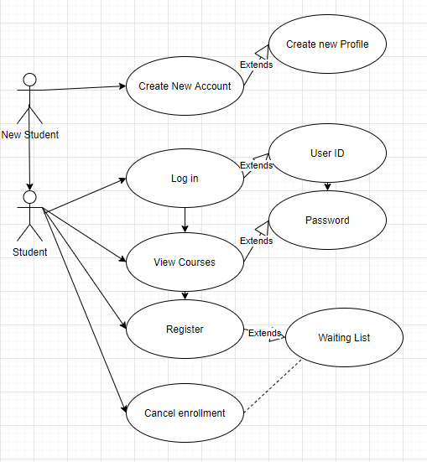
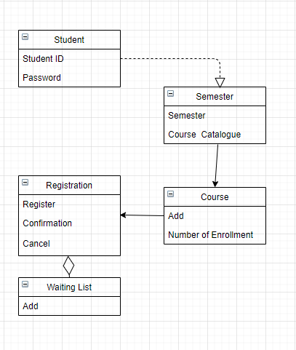
UML Design
Use Case Diagram
Class Diagram

Slide 6
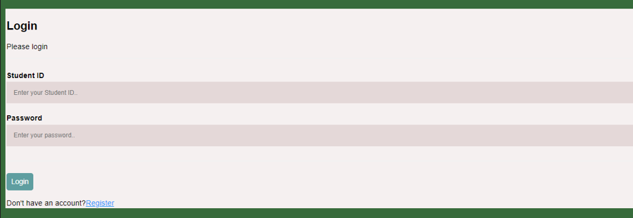
Landing/Login Page
Students can log in with their Student ID and Password
Students can also register if they don’t have an account

Slide 7
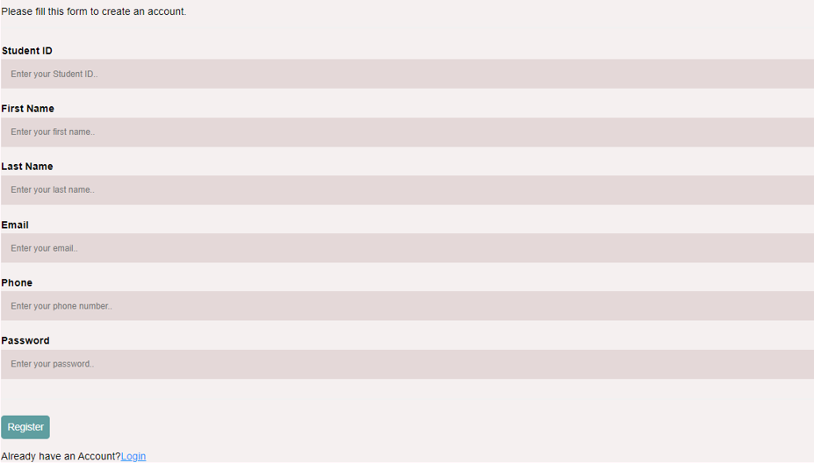
Enrollment Page
Students can enroll by creating a Student ID, Password, and filling out the rest of the fields with their personal information

Slide 8
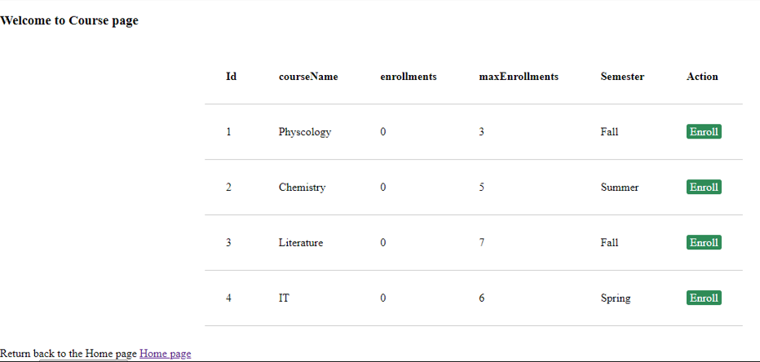
Course Page
Students can view:
List of Courses
Max number of enrollment for course
Semester the course is offered
Option to enroll in the class

Slide 9
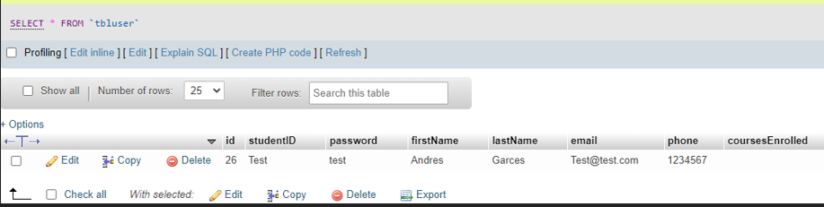
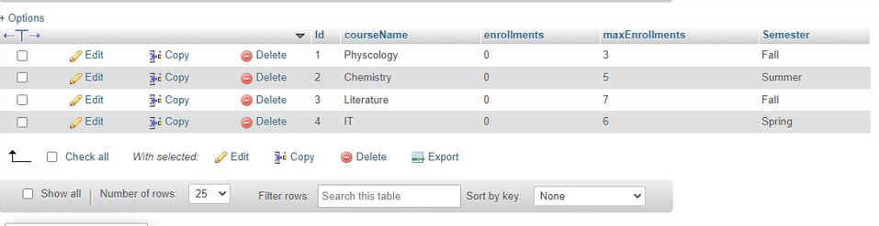
Data tables
Main Table
Student registration
Course Table
Course information

Slide 10
References
Chikh, A., & Alajmi, H. (2014, January 17–19). Towards a dynamic software requirements specification [Paper presentation]. 2014 World Congress on Computer Applications and Information Systems (WCCAIS), Hammamet, Tunisia. https://doi.org/10.1109/WCCAIS.2014.6916656
Hamilton, T. (2021 August 27th). Level of Testing in Software Testing. Guru99. https://www.guru99.com/levels-of-testing.html
Tsui, F., Karam, O., & Bernal, B. (2018). Essentials of software engineering (4th ed.). Jones & Bartlett Learning.
Wiegers, K. E. (1999). Software requirement specifications for <project> (Links to an external site.) [Template]. https://web.cs.dal.ca/~hawkey/3130/srs_template-ieee.doc

